Slide 1
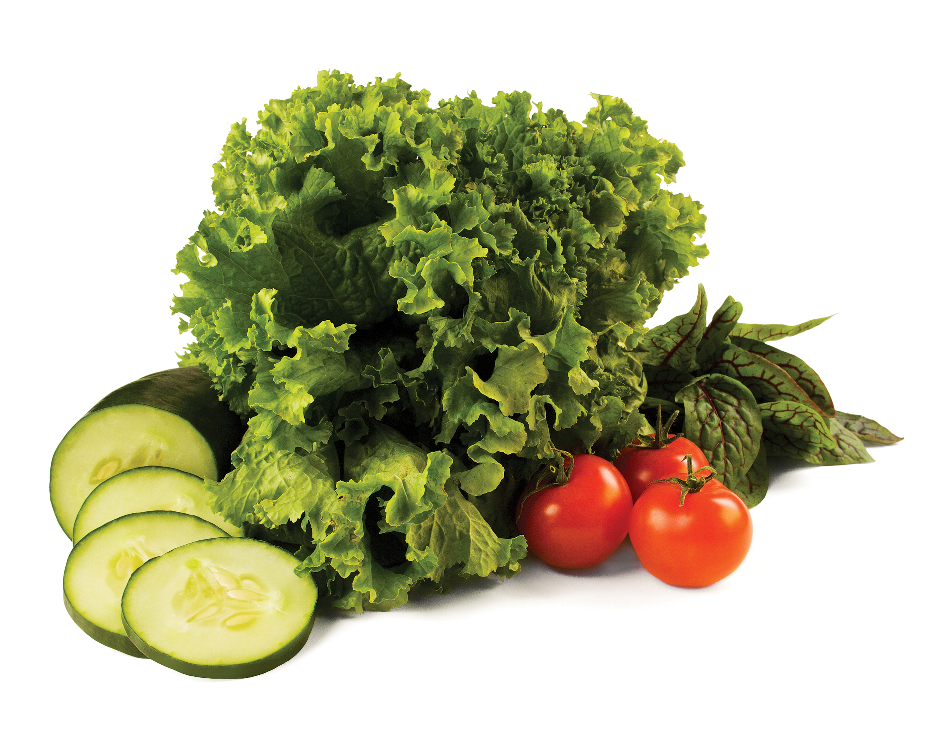
Blood Pressure self-monitoring program
Reducing Sodium Intake
Date
© 2015 YMCA of the USA
Notes:
- Welcome participants to the Blood Pressure Self-Monitoring Program Nutrition Education Seminar
- Introduce yourself
- General Introduction of topic of Nutrition Seminar and its role in the Blood Pressure Management Program
- Share that today’s seminar will be on Reducing Sodium Intake
- Encourage participants to use this opportunity to share ideas and experiences

Slide 2
Reducing Sodium Intake
Overview
Nutrition and Blood Pressure Facts
What is sodium?
Reducing sodium intake
Low sodium meal options
Choosing healthier options
The Low sodium lifestyle: Why does it work?
Notes:
Seminar Overview- briefly lay out the agenda for the seminar- what will be discussed

Slide 3
nutrition & blood pressure
Notes:
Introduce nutrition & blood pressure topic
Nutrition choices have a direct impact on blood pressure. These nutrition seminars address various aspects of eating that we can and should be mindful of to stay healthy and effectively manage blood pressure.

Slide 4
nutrition & Blood pressure
Sodium: Recommended intake
General population: <2,300 mg per day
Special populations: <1,500 mg per day
9/10 Americans consume more than the recommended amount of sodium
The average American consumes ~3,400 mg sodium per day
Excess sodium intake…
Causes the body to retain fluid
Can be hard on the heart
Makes blood pressure management much more difficult
(American Heart Association & Dietary Guidelines for Americans, 2010; AHA, 2015; Dietary Guidelines for Americans, 2010; FDA, 2015)
Notes:
Talking Points
- The 2010 Dietary Guidelines for Americans recommends that everyone consume <2,300 mg sodium per day
- For persons who are at risk for develop heart disease, which includes people over age 51, African American, have high blood pressure, have Diabetes, or have Chronic Kidney Disease, the American Heart Association recommends to limit sodium intake to <1,500 mg per day
- Reducing sodium intake can have a direct impact on blood pressure (it can really help with BP management)
ASK
- What do you think when you hear that the majority of Americans (9 out of 10) American consume more than the recommended amount of sodium?

Slide 5
Nutrition & Blood Pressure
Who should be most concerned about their sodium intake?
People who are at risk for developing heart disease
Age 51+
African American
Hypertension
Diabetes
Chronic kidney disease
*This accounts for about ½ of the U.S. population!
NOTE: It’s important to establish healthy nutrition and lifestyle habits regardless of your health status to promote health & prevent chronic disease
(AHA, 2015)
Notes:
Talking Points
Review who is at risk
Half of the U.S. population is at risk for developing heart disease
It’s important to establish healthy nutrition and lifestyle habits regardless of your health status to promote health & prevent chronic disease. So everyone should be mindful of sodium, not just the people who are at risk for heart disease.

Slide 6
Reducing Sodium Intake
Notes:
Transition to discussion for reducing sodium intake

Slide 7
What is sodium
“Sodium” vs. “Salt”
Sodium (Na) is a mineral that the human body needs for:
Fluid Maintenance
Sodium bonds to water, pulls it into the bloodstream
Nerve impulses
Muscle Function
*The body only needs ~500 mg sodium to function properly
Common table salt is sodium chloride (NaCl)
About 40% of the weight of sodium chloride is sodium (Na)
90% of Americans’ sodium intake comes from sodium chloride
(AHA, 2015)
Notes:
Talking Points
- It’s a common misconception that salt and pure sodium are the same thing. That’s not true
- Discuss difference between sodium (Na) and table salt (NaCl)
- Like many other minerals our body needs them to function, but too much of most things can be harmful.

Slide 8
What Is Sodium
Consuming too much sodium leads to excess sodium in the bloodstream
Excess sodium in the bloodstream ➔ excess fluid that is pulled into the bloodstream
Total blood volume in the body increases
More blood flowing through the body
Blood pressure increases
(AHA, 2015)
Notes:
Talking Points
- Explain the effects of too much sodium consumption leading to excess sodium in the bloodstream, and how it leads to an increase in blood pressure.
- Give analogy of a garden hose: When we turn on the water a certain level of water pressure is in the hose; however, when we turn up the water in the hose, the water pressure in the hose increases because more water is flowing through it. This increased pressure is the same thing we see in our bodies.

Slide 9
Reducing Sodium Intake
A visual on sodium…
¼ tsp. salt = 575 mg sodium
½ tsp. salt = 1,250 mg sodium
¾ tsp. salt = 1,725 mg sodium
1 tsp. salt = 2,300 mg sodium
*Try to consume <1,500 mg sodium per day
<¾ tsp. salt per day
(AHA, 2015)
Notes:
ASK
- We saw earlier that our bodies only need 500mg of sodium to function properly. How many teaspoons of salt do you think would amount to about 500 mg of sodium?
After responses, build slide to reveal
- How do you feel about this? Are you surprised?
Talking points
- We should try to consume less than 1,500 mg sodium per day, which is the recommendation. This is less than ¾ of a teaspoon

Slide 10
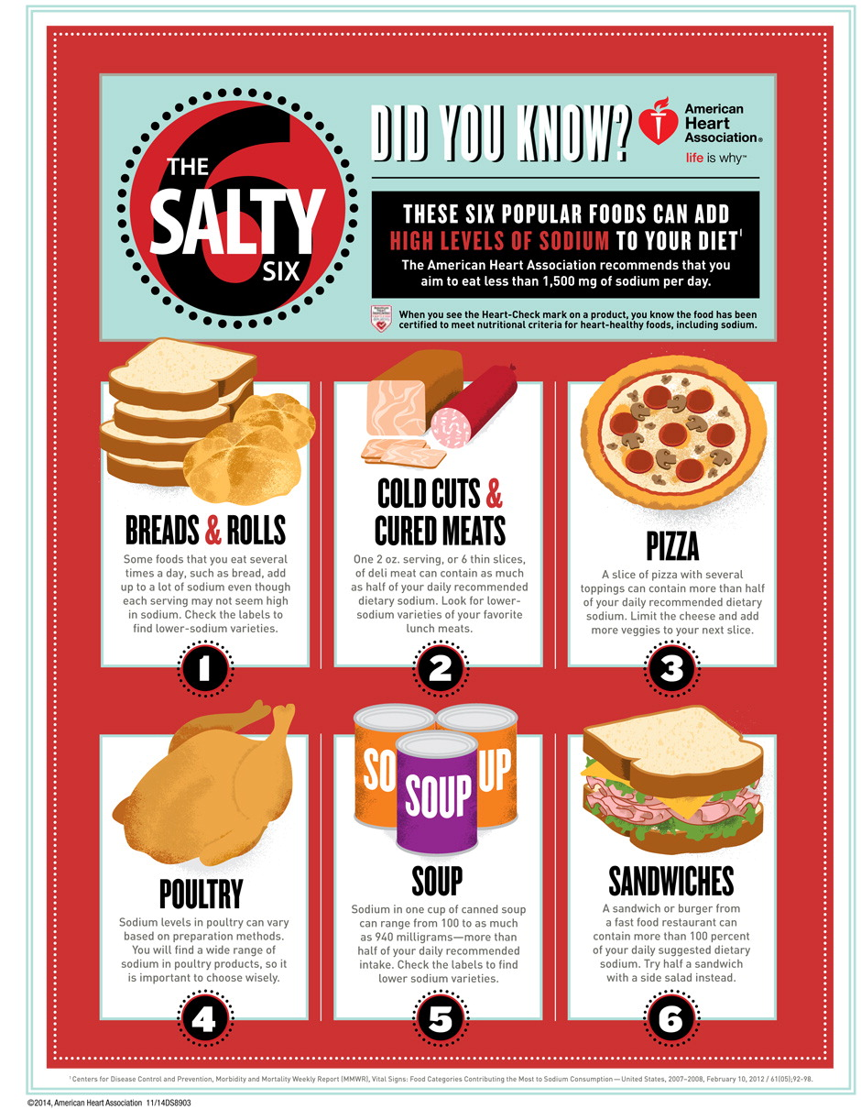
Reducing Sodium Intake
Where does salt come from?
More than 75% of sodium that we eat comes from processed foods
Chips, pretzels, etc.
Bread
Condiments
Cheeses
Processed Meats
Pizza
Canned goods
Baked goods
Adding salt to foods
Naturally-occurring
(CDC, 2015 ; AHA, 2015)
Notes:
Ask
- What foods do you think are high in sodium?
After responses build slide to reveal list
- What is surprising on this list? (*food labels that call out high levels of sodium can also be brought in)
Talking Points
Most of the salt in our diets comes from processed foods, which is usually anything that comes in a package from the store. Most things we eat go through some sort of processing before we get them from the store
Salt in our diet also comes from salting our food, but not as much as you would think. A lot of it is in the processed foods we eat, which is dangerous because often we don’t realize it when we are consuming a lot of sodium.
Some sodium is naturally occurring in fruits, vegetables and meats too.
Ask
Where do you think most of the salt you are eating is coming from?

Slide 11
Reducing Sodium Intake
What can you do?
Eat more fruits & vegetables
Fresh, Frozen, No salt added canned vegetables
Rinse canned vegetables & beans to reduce sodium!
Use fresh poultry, lean meat, & fish instead of processed
Limit sauces, ready-made mixes, & instant products
Use spices to flavor food
Ask for no salt when dining out
Read nutrition labels to compare sodium levels– choose the options that are lowest in sodium!
Buy low sodium, lower sodium, reduced sodium, or no salt added options when available
(CDC, 2015)
Notes:
Ask
- What are some ways you can reduce sodium in your diet? Listen for responses then build slide
Talking Points
- Discuss strategies for reducing sodium intake
- Even if canned goods aren’t reduced sodium they can be rinsed to reduce the sodium
- Reduce the amount of pre-made processed foods you eat
- Prepare your own foods so you know what is in them and you can control the amount of sodium you put in.

Slide 12
Reducing Sodium Intake
What does it mean?
Sodium Free
<5 mg sodium per serving & contains no sodium chloride
Very Low Sodium
<35 mg per serving
Low-Sodium
<140 mg per serving
Reduced (or less) sodium
At least 25% or less sodium per serving than the usual sodium level of the product
Light (for sodium-reduced products)
For “low calorie” and “low fat” foods that contain at least 50% reduced sodium per serving
(AHA, 2015)
Notes:
Talking Points
- Food labels can have many claims on them related to sodium content. If it has a claim on it, it means it is regulated.
- When you read the label it’s important to look at serving size and how many servings there are per package. Some packages will have 2-4 servings.
- Each claim has a quantitative meaning behind it. Let’s take a look. Build slide and review sodium content meanings.

Slide 13
Reducing Sodium Intake Throughout the Day
Sample Meals
Breakfast
Whole wheat toast with peanut butter, banana, blueberries, & a cup of milk
Lunch
Quinoa salad with black beans (rinsed), scallions, corn, red peppers, mango and avocado with a cup of milk
Dinner
Grilled chicken (seasoned with rosemary and lemon) with brown rice, broccoli and a cup of milk
Notes:
Talking Points
- Making meals yourself is a great way to be sure you are not consuming a lot of sodium
- None of these meals have any added sodium
Ask:
- For breakfast, what are sources of sodium? Listen for bread and nut butter. Nut butter could be switched to no salt added
- For dinner, what about brown rice, where could sodium be added in the process? Listen for ‘in the water it’s cooked in, after it’s cooked.’
- Can anyone think of other meals that would be in line with reducing sodium?

Slide 14
Choosing healthier foods
This or That?
Breakfast
Breakfast sandwich with 1 egg, 1 slice of cheddar cheese, & turkey bacon on whole wheat English muffin with a cup of water
Yogurt with oats, blueberries, & sliced banana with a cup of water
Lunch
Greek salad with spinach, tomatoes, cucumbers, low-fat feta cheese, kalamata olives, pepperoncinis & Greek dressing with a cup of water
Whole wheat wrap with tomatoes, spinach, black beans, avocado, olive oil & balsamic vinegar
Dinner
Grilled chicken with brown rice, steamed broccoli & a cup of milk
Turkey burger with lettuce, tomato, onion, ketchup, mustard, & swiss cheese on a whole wheat bun with baked sweet potato wedges a cup of water
Notes:
Talking Points
Review each meal and ask which option has less sodium for each of the meals
Ask
How can we improve some of the healthier options?
B: Breakfast sandwich with 1 egg, low sodium cheese and spinach OR whole wheat toast with no salt added peanut butter and an apple
L: Greek salad with spinach, tomatoes, cucumbers, ½ the feta cheese, ½ the olives, no pepperoncinis, olive oil and balsamic vinegar OR dressing on the side so you can control how much is on it
D: Open faced turkey burger with lettuce, tomato, onion, low sodium condiments or no condiments, no cheese, baked sweet potato wedges (no salt added) OR baked sweet potato OR substitute broccoli or other veggie on the side, cup of milk. Note: There can be a lot of sodium in a burger-bread, turkey, cheese, condiments, salt on potatoes

Slide 15
Why Reducing Sodium works
Establish healthy nutrition and lifestyle habits
Promote health
Prevent chronic disease
Reduce fluid retention
Weight management
Blood pressure management
Ultimately, you will feel better!
Eliminate bloating & weight gain associated with fluid retention
Easier to manage blood pressure
Notes:
Ask:
-Why do you think reducing sodium works?
Review slide
Talking Point
- Overall, reducing sodium intake contributes to a healthy and more nutritious lifestyle

Slide 16
discussion
Notes:
Transition to discussion about reducing sodium intake…

Slide 17
Discussion
Think about what you have eaten today or yesterday…
What kinds of foods have you eaten that would help you reduce your sodium intake?
How could you change some of your food choices so you are taking in less sodium throughout the day?
Think about after you have eaten something that is really salty or after a day of consuming a lot of salt…
How do you feel?
Think about all the kinds of “low sodium” foods that you can purchase at the grocery store…
After learning about reducing your sodium intake and what “low sodium” means on a label, what can you do to ensure that you aren’t taking in too much sodium?
Notes:
Talking Points/Ask
Use questions on the slide to discuss participant’s food choices. Facilitate discussion around how they might change aspects of their diet to consume less sodium
- How could you change some of your food choices so that you’re taking in less sodium throughout the day?
- How do you feel after consuming a lot of salt: bloated, thirsty, want more-does this feel good/healthy?
- Look at nutrition facts to see how much sodium is really in a product. If it’s more than you thought how could you reduce it? Listen for: reduce portion size, mix with other food/liquid that doesn’t have salt (add water to soup, mix in veggies for more volume and to keep sodium down), prepare your own food so you know what is in them and how much sodium is in them.

Slide 18
Physical activity and blood pressure management

Slide 19
Physical Activity and blood pressure management
Evidence has shown that regular physical activity can lead to a significant reduction in blood pressure and improve other cardiovascular risks.
Moderate physical activity has also been proven to decrease blood pressure in hypertensive patients who are less responsive to medical treatment.
30 minutes of physical activity a day (equivalent to brisk walking) 6-7 days each week (180 minutes each week) may result in better management or a reduction in one’s blood pressure.
Notes:
Talking Points
- Review slide
- Emphasize physical activity should be the equivalent of a brisk walk
Ask
- What are some other potential benefits to working towards 180 minutes of physical activity a week?
- What are some ways you can add physical activity to your day?
- Emphasize physical activity should be the equivalent of a brisk walk

Slide 20
Physical Activity and blood pressure management
Resources to support this claim include, but are not limited to:
"Exercise in Resistant Hypertension: Aerobic Exercise Reduces Blood Pressure in Resistant Hypertension." Hypertension. 2012
"Hypertension." Exercise Testing and Exercise Prescription for Special Cases: Theoretical Basis and Clinical Application. 2005
"Regular Aerobic Exercise Augments Endothelium-Dependent Vascular Relaxation in Normotensive As Well As Hypertensive Subjects" Circulation. 1999
"The effects of aerobic exercise and T'ai Chi on blood pressure in older people: results of a randomized trial." Journal of the American Geriatrics Society. 1999

Slide 21
Thank You
Notes:
Talking Points
- Do a quick debrief of their takeaways from the session and changes they will make to reduce sodium in their diet.
- Pass out Choose Foods Low in Sodium and Salt and Sodium Tip Sheet.
- Share information on upcoming Nutrition Education Seminars.
- Remind participants to self-monitor and track their blood pressure at home and attend office hours.

